Slide 1
Twenty Years Gone
By Kristin Gjelaj, Jessica Lewis, Chelsea Moore and Hailey McCloskey

Slide 2
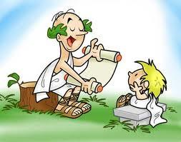
Necessary Background
Odysseus just came back after being on a journey for twenty years. He reunites with his son, Telemachus, for the first time since his birth.

Slide 3
Brief Summary of the Section
Athena tells Odysseus about what has been going on with his family in Ithaca.
Telemachus and Odysseus must fight off the suitors
Athena disguises Odysseus as a peasant.
Telemachus does not recognize Odysseus or believe he is his father.
He explains that Athena disguised him and they embrace each other with tears of joy.

Slide 4
Brief Summary of the section(The Plan)
Odysseus shares how he got home. He asks Telemachus if they would be able to fight off the suitors themselves.
Telemachus believes that Odysseus and he could defeat the suitors themselves.
Odysseus is going to let the suitors make fun of him as he is disguised.
Telemachus is to hide the suitors weapons and not to tell anyone that Odysseus has returned.

Slide 5
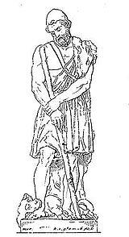
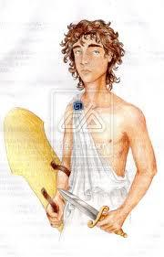
Description of the Characters
Odysseus- Humble, handsome, loyal,
intelligent, kind,
hardworking, hero, King of Ithaca
Telemachus- Son of Odysseus
and Penelope, heir to the throne,
must create his own reputation

Slide 6
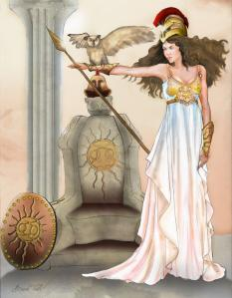
Description of the Characters
Eumaeus- Odysseus’ old and faithful swineherd, because of his loyalty he is included in the plan
Athena- Powerful, takes pity on
Odysseus, helpful,

Slide 7
Main Conflict
Odysseus and Telemachus must fight off Penelope’s suitors who are trying to take Odysseus’ Kingdom of Ithaca
The use of self restraint while planning the surprise attack on the suitors

Slide 8
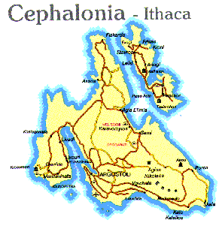
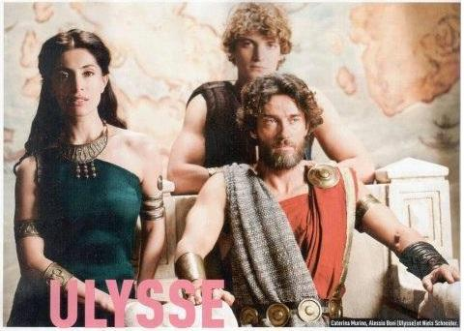
Odysseus’s Motivation
Telemachus
Penelope
His Kingdom

Slide 9
Theme/Lesson
Benefits of loyalty
Humility makes people more willing to help.

Slide 10
Rebirth of Odysseus
Athena takes pity on him and disguises him physically
He also is changed mentally; he is now humble
The gods feel he is no longer arrogant and want to help him

Slide 11
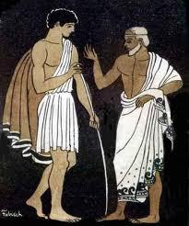
Symbolism
Odysseus’ white cloak: his rebirth

Slide 12
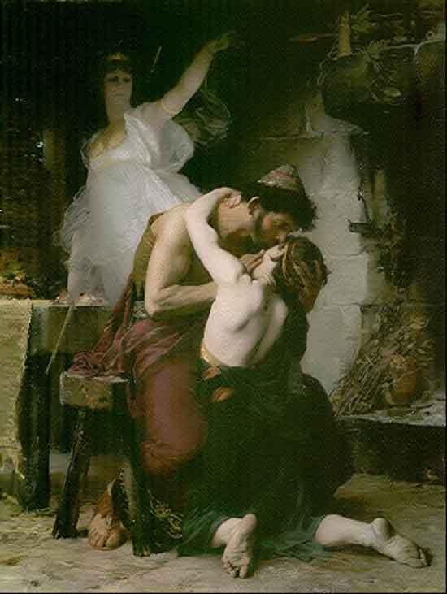
Significant passages
“Telemachus weeps in realization and they weep together” Homer

Slide 13
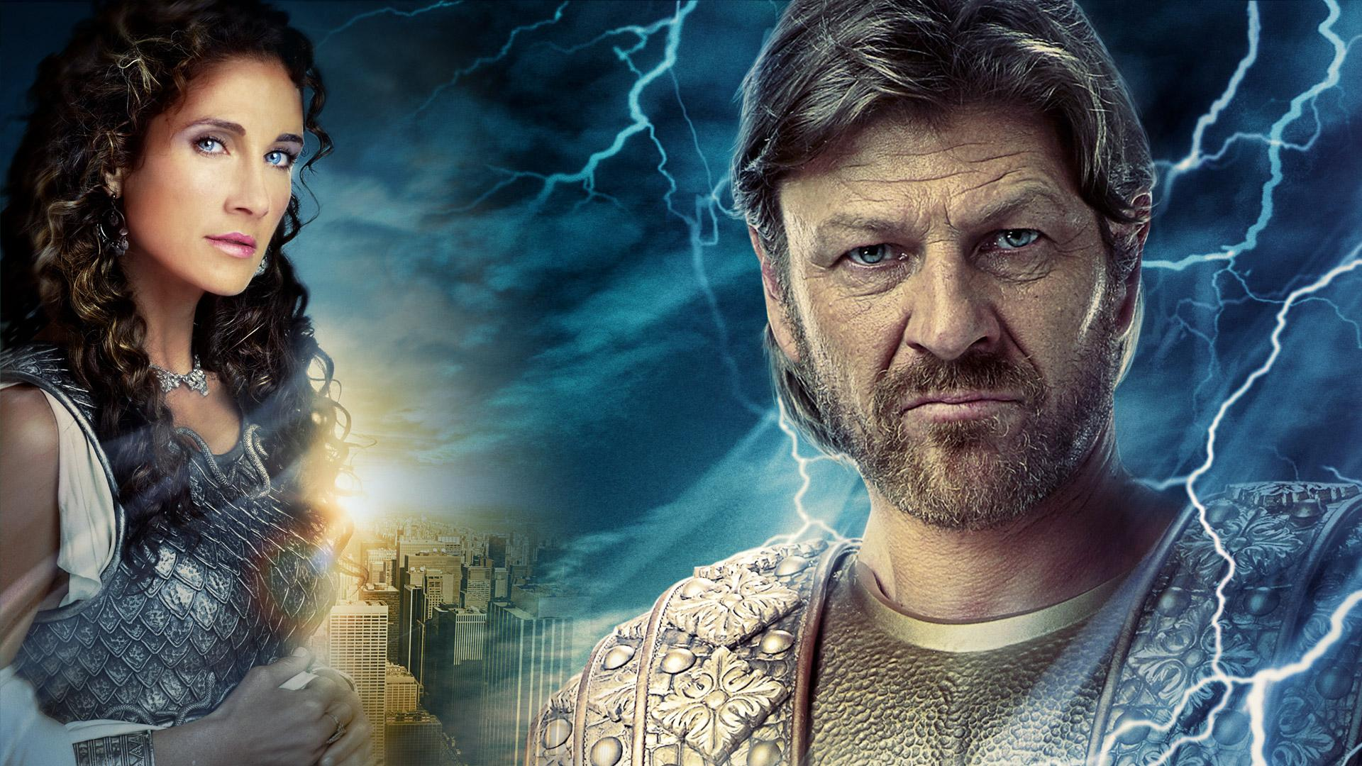
Significant Passages
“It is no hard thing for the gods of heaven to glorify a man or bring him low” Odysseus
“The gods, Zeus and Athena, are on our side” Odysseus

Slide 14
Significant Passages
“Tell no one I’m here (even Penelope) until we know who’s on our side” Odysseus

Slide 15
Discussion Questions
Is it justified for Athena to take pity and involve herself in Odysseus’ affairs?
Do you think that Telemachus knew or had an idea that the suitors wanted to kill him to inherit the crown should Odysseus never return?

