Slide 1
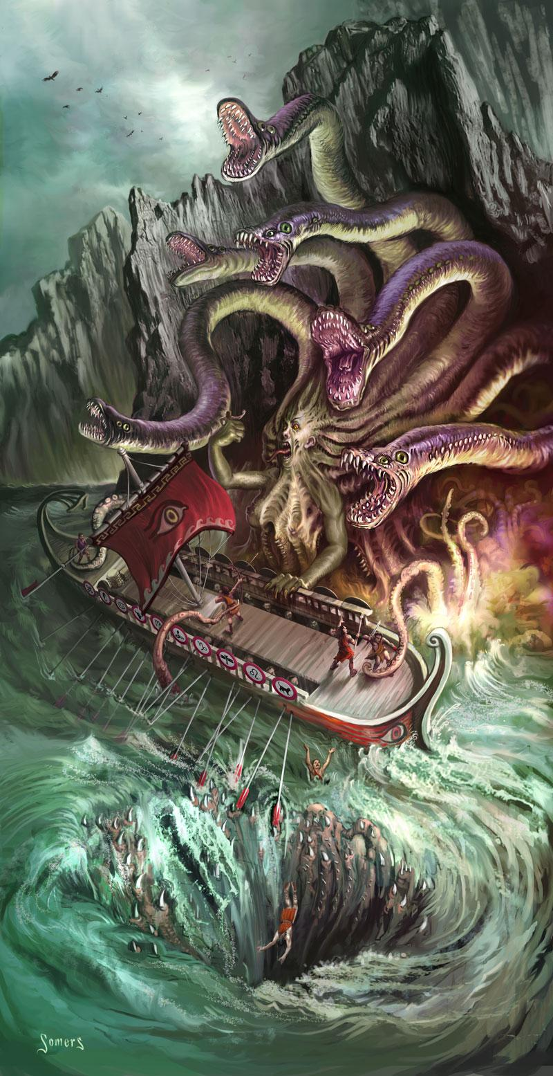
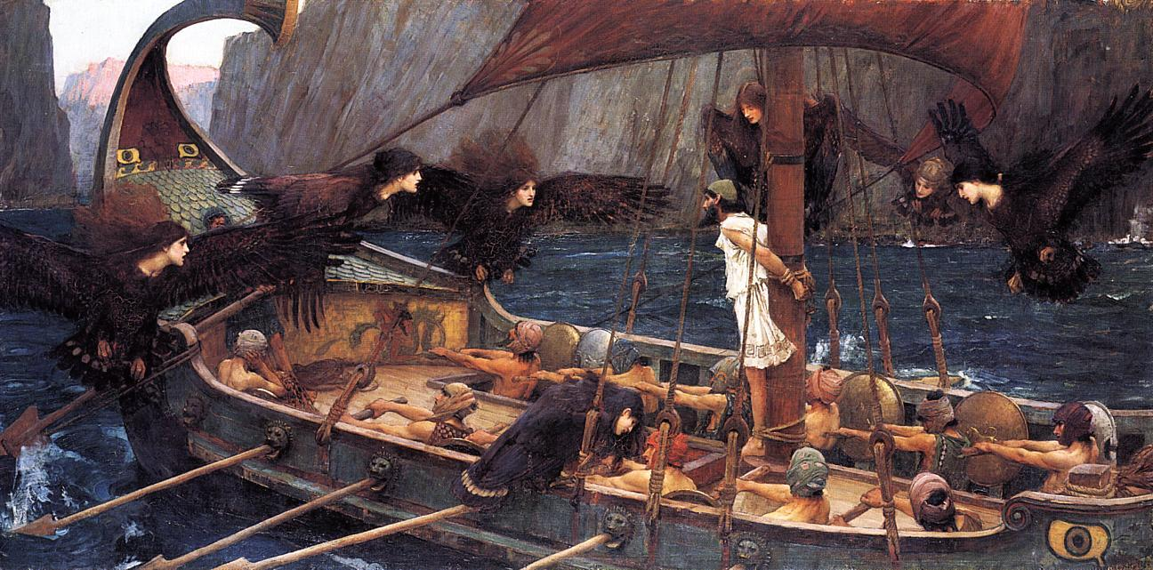
The Sirens
&
Scylla and Charybdis
By: Olivia Dellacava
&
Zoe Telenick

Slide 2
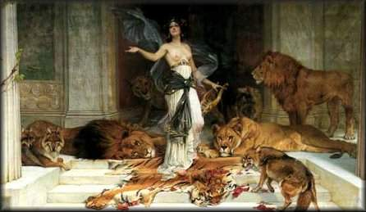
Background
When Odysseus returned to Aeaea the goddess Circe warned him about beasts and trouble that was to come. Such beasts include, the Sirens, the whirlpool CHarybdis and the cattle of the sun God. From there, Odysseus returns to his crew and they continue their journey home.

Slide 3
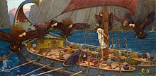
Summary of Sections
The Sirens
Circe asked Odysseus alone to listen to the song of the Sirens
Odysseus is clever and puts wax in crews ears so they can’t hear
Odysseus has the crew tie him up so he cannot try and get any closer to the creatures
Oce they are close enough to the Sirens so they can hear their song, Odysseus begins to struggle, trying to get closer to the creatures
the crew holds him down when Odysseus struggles
The crew and Odysseus get by safely
Scylla and Charybdis
shortly after escaping the sirens they are met with smoke and white water
the crew is terrified and Odysseus has to calm them by encouraging them
He says he will protect them
crew is kind of cowardly
Odysseus does not tell them that they are going to face Scylla
Scylla shows herself and causes havoc amongst the ship
Takes six of best men in the crew
odysseus pitys them and feels bad for not being able to save them
They continue on in their journey leaving Scylla and Charybdis behind

Slide 4
Characters of the Sirens and Scylla and Charybdis
Odysseus: A king of Ithaca. Odysseus is brave and wise. However, in the Sirens, we see Odysseus give into desire and go against what he believes in
Circe: is a minor goddess of magic who provides Odysseus advice on his enemies Odysseus would face.
Sirens:Mythical beings who lure men into rocky shores with their beautiful voices and cause them to crash
Odysseus’ men: Cowardly and foolish but loyal
Odysseus: We see a kinder side of Odysseus. He is concerned for his crew, and tries to comfort them.
Charybdis: A seas monster that makes its home in a narrow strait. The monster creates large whirlpool, a danger to ships.It could take down Odysseus’ entire ship.
Scylla: Another sea monster, alongside Charybdis. Sailors would avoid Charybdis and go past Scylla instead.

Slide 5
The Main Conflicts
The Sirens
The Sirens will make the men crash their boat into the rocks
Odysseus has to keep the men from hearing the sirens, only he can hear the sirens.
Scylla and Charybdis
Scylla is coming and will attack them
Odysseus has to ready his crew for battle and make them less cowardly
Scylla takes six men and Odysseus feels guilty and pities them
He has to overcome his feelings and continue on

Slide 6
Odysseus Motivation
Odysseus had the same motivation in both stories. It was to get back to his wife Penelope who was waiting patiently for him back home with their son.

Slide 7
The Theme/message
The Sirens
Dont give into desires
You have to be strong in hard times
sometimes you have to take the lead
Scylla and Charybdis
Sometimes you have to overlook your feelings and keep going for the sake of others
Sometimes you have to take charge and help others

Slide 8
Characters Lesson
In The Sirens. Odysseus and his crew learn what desire could cost them . If they had given into the Sirens cry, then they would have crashed into the rocks and hit their death.
In Scylla and Charybdis learns that most of Circe’s predictions have indeed come true. Odysseus also sees the impact of the choices he makes, and learns how he has to keep going no matter what

Slide 9
Significant Passages
The Sirens
“This was the haunting song the Sirens sang, and I longed to listen, commanding my crew by my expression to set me free. But they bent to their oars and rowed harder, while Perimedes and Eurylochus rose and tightened my bonds and added more rope. Not till they had rowed beyond the Sirens, so we no longer heard their voices and song, did my loyal friends clear the wax that plugged their ears, and untie me.”
Scylla and Charybdis
“My crew turned pale as we gazed at her, fearing destruction, but even as we did so Scylla seized six of my strongest and ablest men from the deck. As I looked along the swift ship towards my friends I saw their arms and legs dangling above me. In anguish they cried my name aloud one last time, then each of Scylla’s heads dragged a man writhing towards the rock, as a fisherman on a jutting crag casts his bait to lure small fish, lowers an ox-horn on a long pole into the sea, and catching a fish flings it ashore. There at the entrance to her cave she devoured them, as they shrieked and reached out their hands to me in their last dreadful throes. It was the most pitiable sight of all I saw exploring the pathways of the sea.”

Slide 10
Discussion Questions
Why did Circe help Odysseus?
Why is Odysseus the only one who listens to the song?
Why do you think Odysseus chooses Scylla?
What do you think the Sirens song meant?

Slide 11
The Sirens Song
This way, oh turn your bows, Achae’s glory, As all the world allows- Moor and be merry
Sweet coupled airs we sing, No lonely seafarer Holds clear of entering Our green mirror
Pleased by each purling notre Like honey twining From her throat and my throat Who lies a-pining?
Sea rovers here take joy Voyaging onward, As our song of Troy Graybeard and rower-boy Goeth more learned
All feats on that great field In the long warfare, Dark days the bright gods willed, Wounds you bore there Argos old soldiery
Oh Troy beach teeming, Charmed out of time we see, No life on Earth can be hid from our dreaming
http://www.youtube.com/watch?v=_dl2L4v6ecM
http://www.youtube.com/watch?v=0R--FtzSx2o

