Slide 1
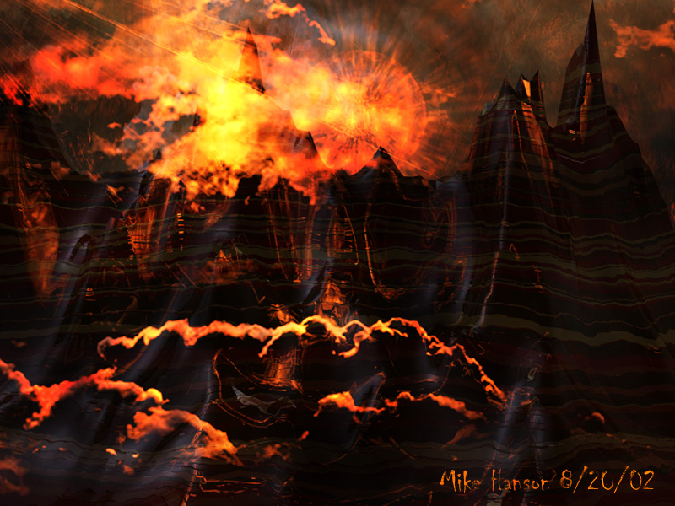
The Land of the Dead
By Natalie Tromer, Avalon Peyton, and Caitlin Skae

Slide 2
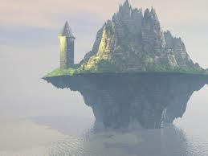
Aeolia
Aeolus- King of the Winds
Aelous gives Odyseus sack as a gift
The Sack is filled with all the winds except the West Wind
Odyseuss’s men open the sack when they are near home and the winds take them back to Aeolia
Aeolus says they are detested by the Gods and refuses them entrance to his island

Slide 3
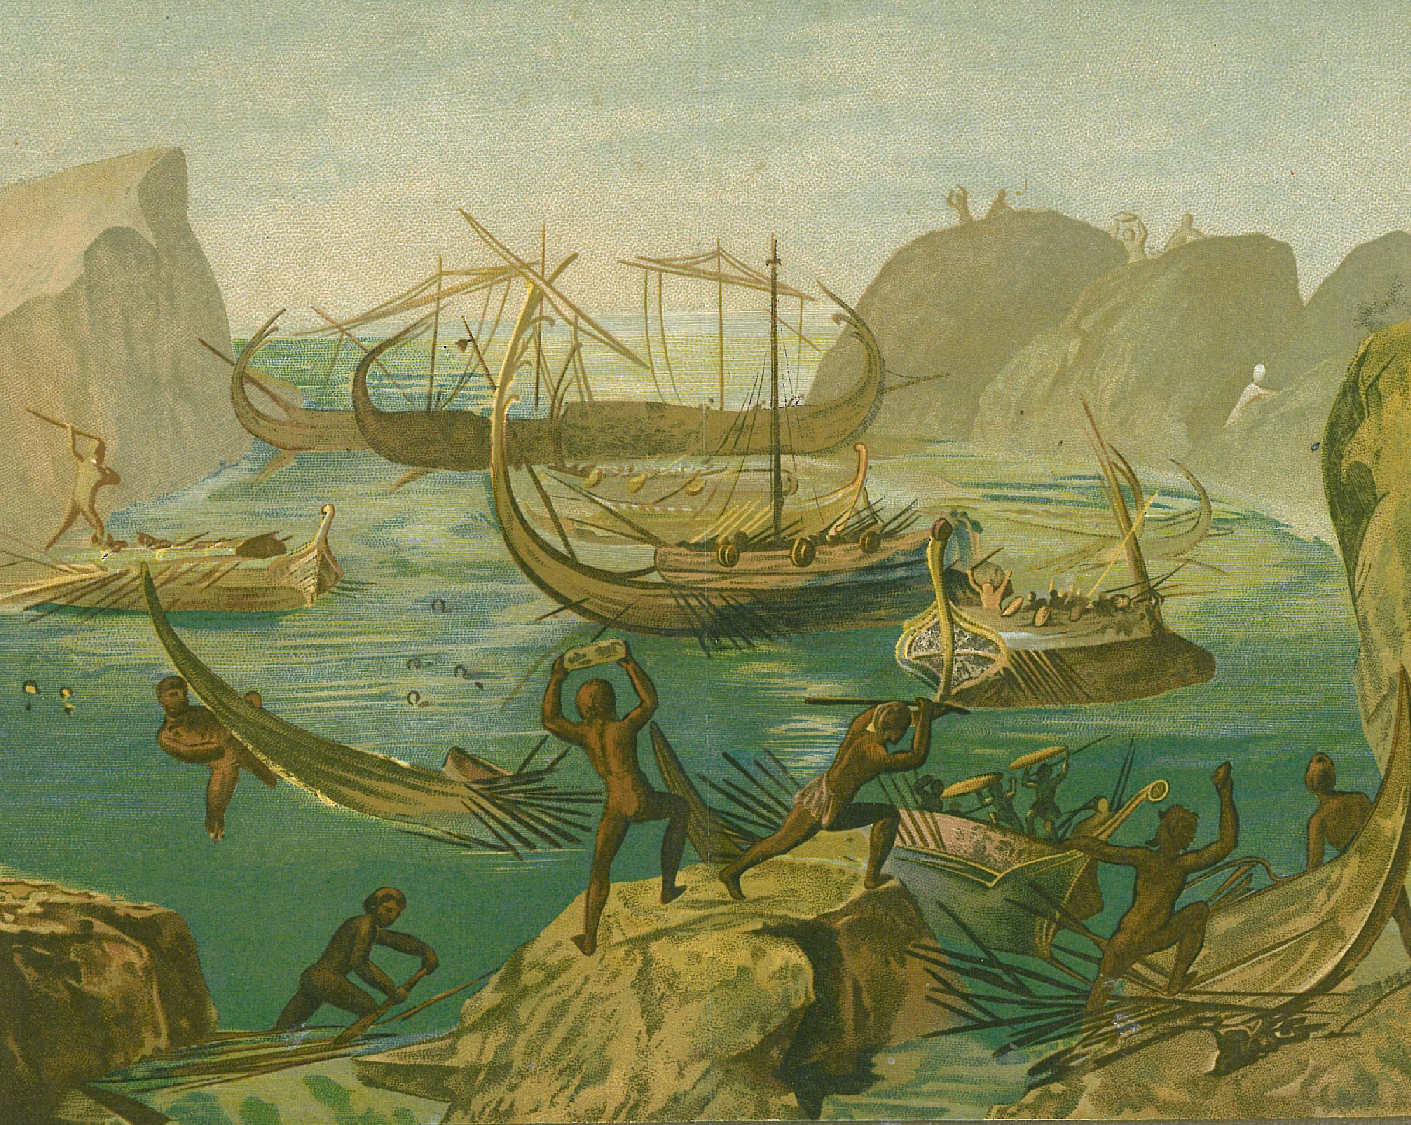
Land of the Laestrygonians
Land of Cannibals
Cannibals destroy all ships and crew on the ships excluding the one Odyseus was on.

Slide 4
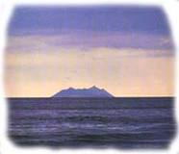
Aeaea
Circe (sorceress-goddess) rules island
Turns half of crew into swine (pigs)
Odyseus is protected by a magical herb and goes to ask her what to do
She tells him he must go to the land of the dead and talks to Tiresias, the blind prophet
Escapes from island a year after his arrival

Slide 5
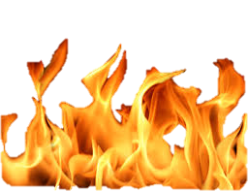
THE LAND OF THE DEAD

Slide 6
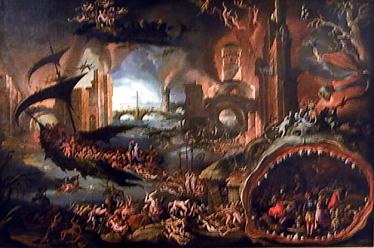
Sacrifices he makes to stir spirits
“Spays a pit”
Scatters Barley
Pours sweet milk and honey, sweet wine, and water on the pit
Tells dead he will make sacrifices for them
Sacrifices best black lamb for Tiresias

Slide 7
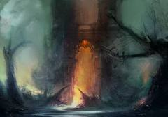
Souls Stir
Souls come up from Erebus
Erebus: Passway to Hades
Odyseus guards the pit from phantoms with his sword
Tells officers to skin sheep and offer the skins to the God of Death and Persephone

Slide 8
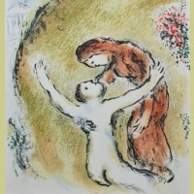
Elpenor
One of the dead crew members
Gives Odyseus advice
Explains how he died
Asks for a proper send off and for him to pay respects

Slide 9
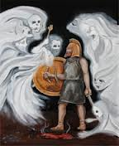
Odysseus’ Mother
Died while Odysseus was away
He did not know she was dead until that moment
He breaks down in tears

Slide 10
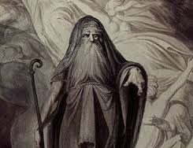
Tiresias
Asks for blood in return for his future
His future:
The Thunder God will cause problems
He must go to Thrinacia
Find herd of Helios
Avoid the herd
Don’t raid beeves

Slide 11
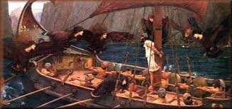
If he raids the beeves…
Ship and crew will be destroyed
Odyseus will be lost for years
When he finally gets home, there will be problems

Slide 12
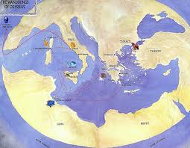
Problems at Home
Men will be eating Odysseus’ livestock and dating his wife

Slide 13
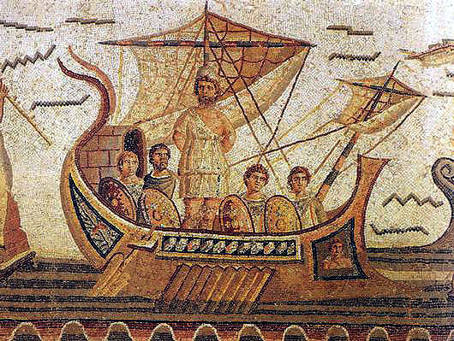
If this happens
Kill the men
Sail to the land of people who do not know
Odyseus will know he is there when someone asks him about the “Winnowing fan on his shoulder”
Then carry out Hecatombs (large scale sacrifice) to Poseidon

Slide 14
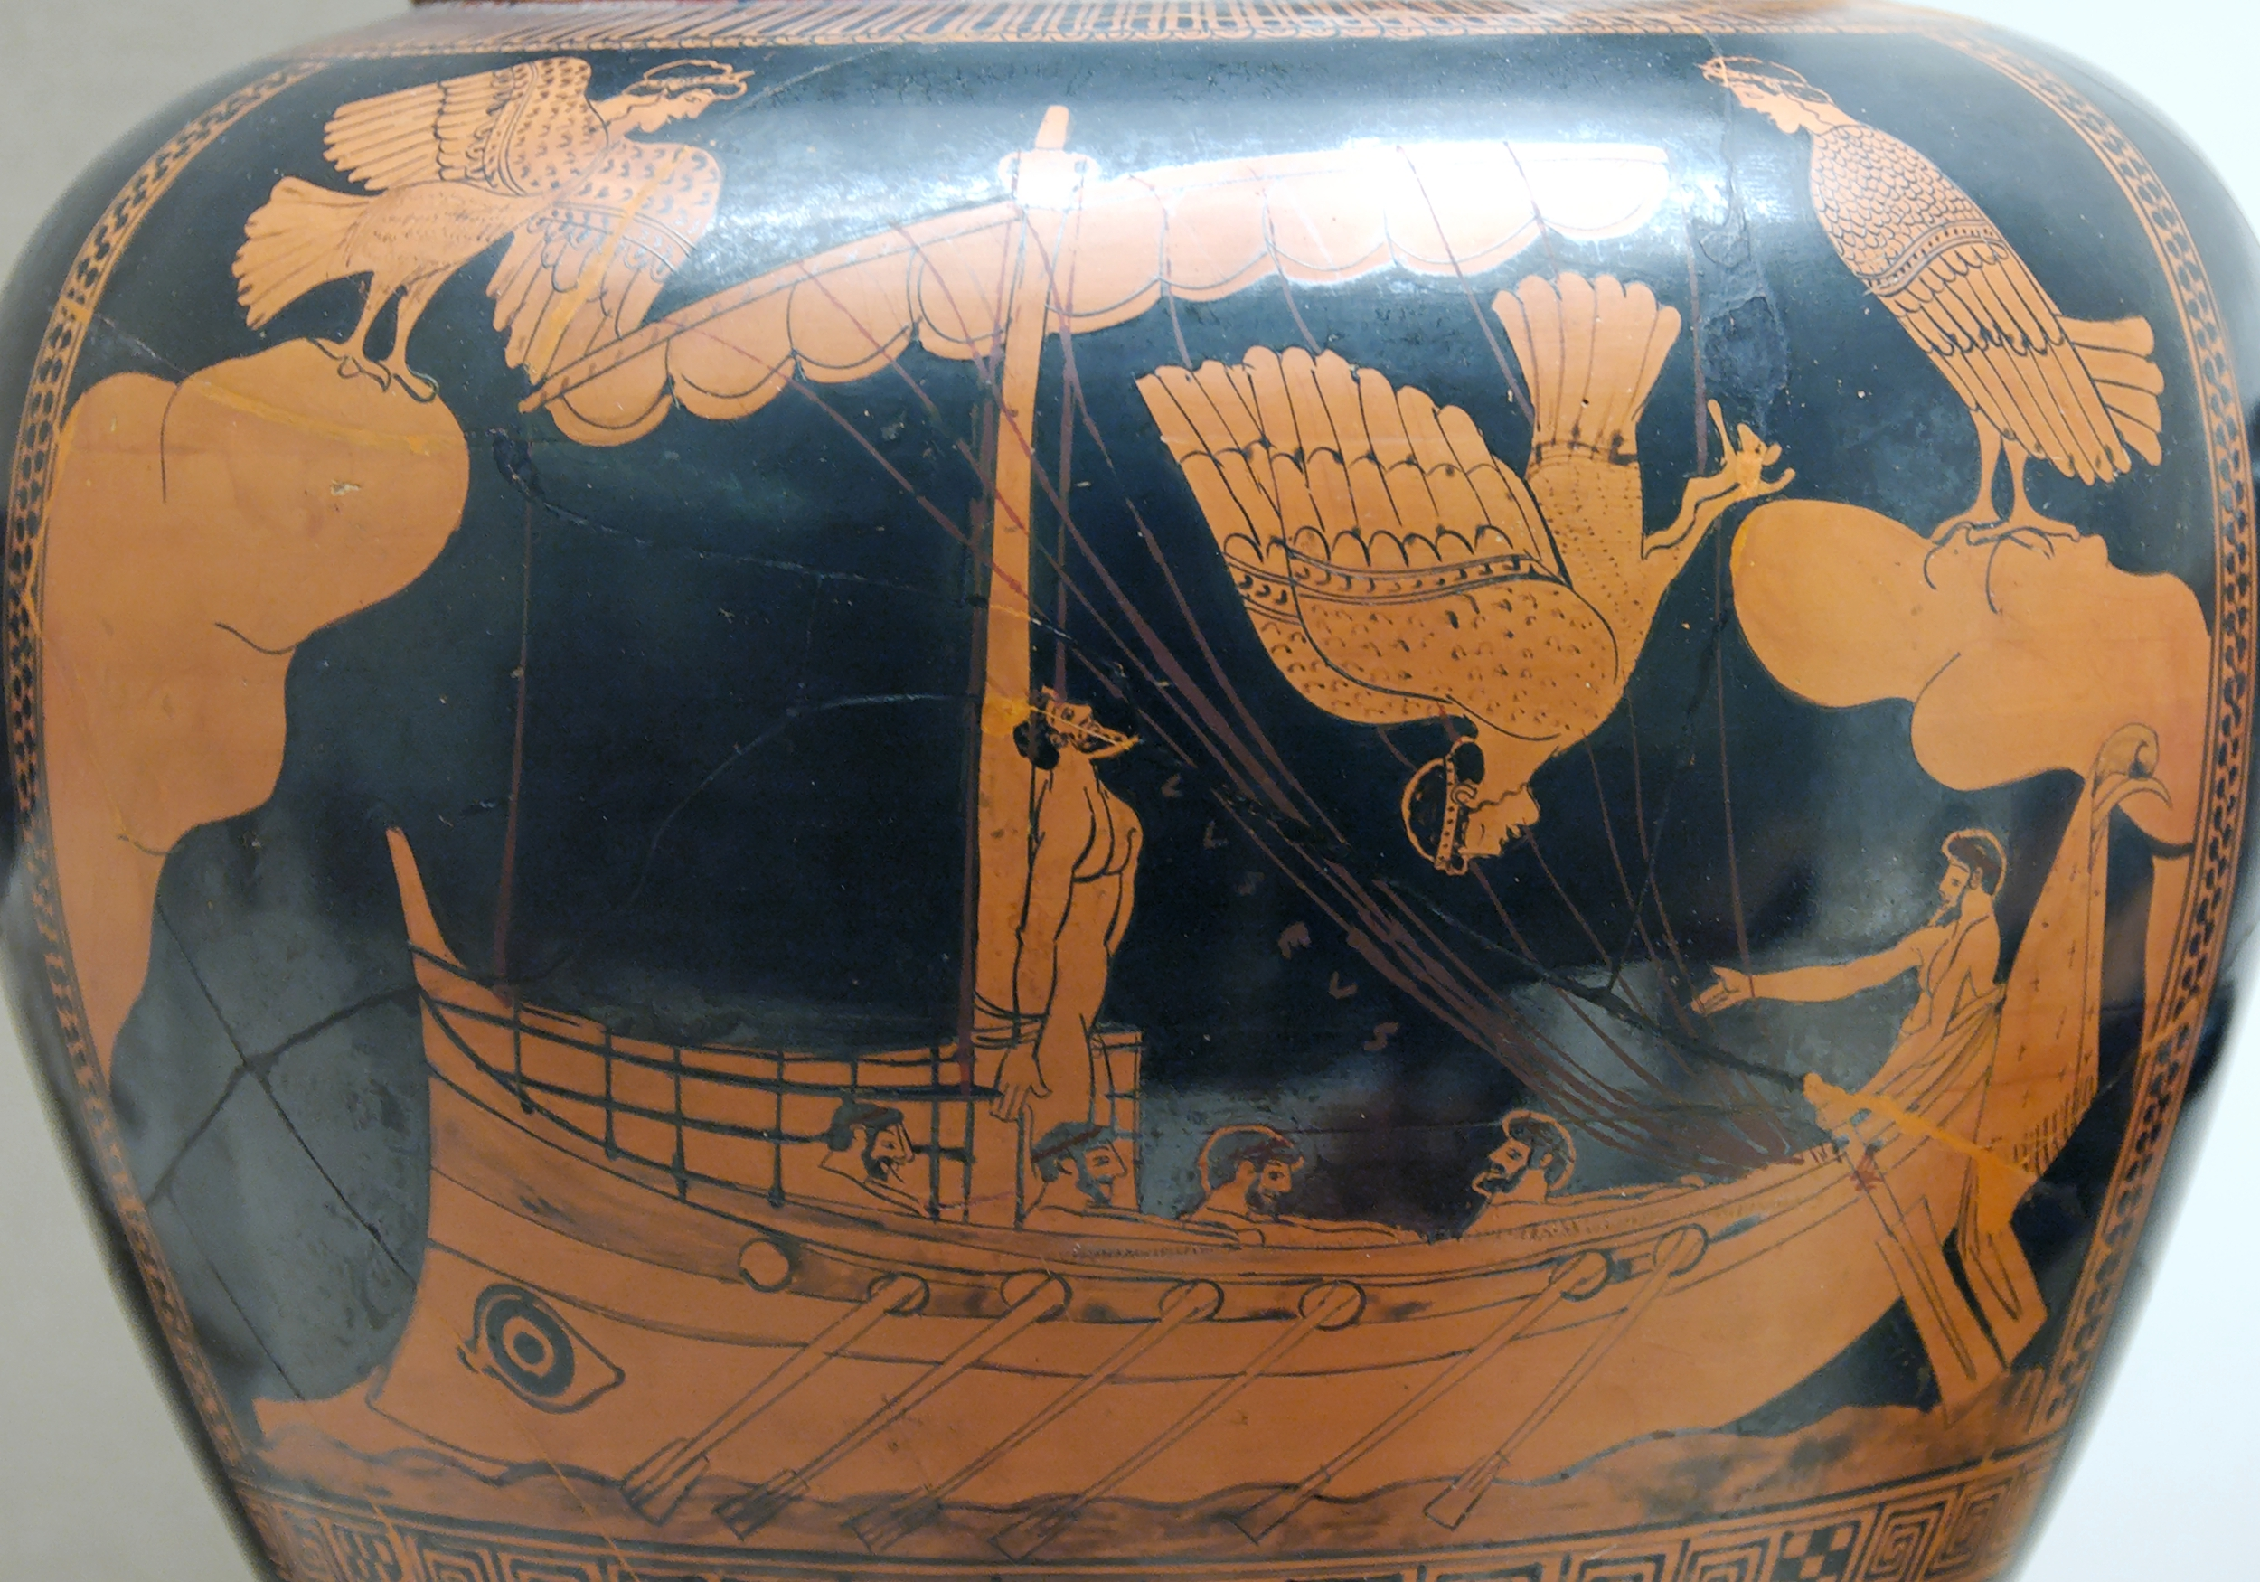
The Ending
Odysseus will die at sea of old age

Slide 15
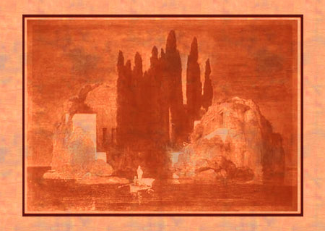
Conflict
Bag of winds takes them from almost home back to the beginning
Crew being reduced
Eaten by cannibals
Circe turns them into pigs

Slide 16
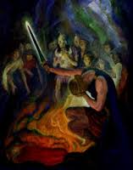
Conflict in the Land of the Dead
Has to keep mother away from pit
In his future:
Men at home he kills
Raiding the beeves

Slide 17
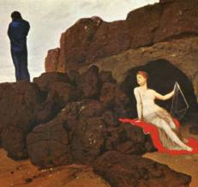
Characters
Odysseus- Protagonist
Aeolus- King of the Winds
Circe- sorceress-goddess
Tiresias- Blind Prophet
Elpenor- Dead crew member

Slide 18
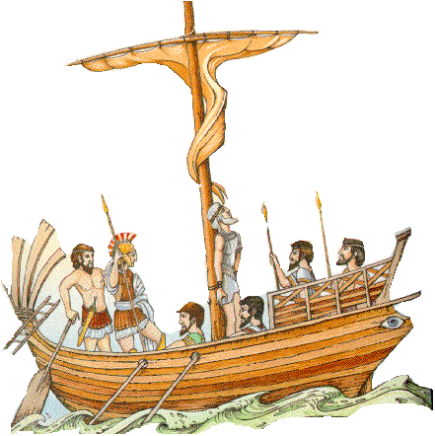
Odysseus’ Motivation
He wants to get home to his wife and son

Slide 19
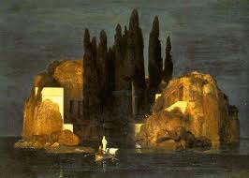
The Moral
Respect the dead
Self Restraint

Slide 20
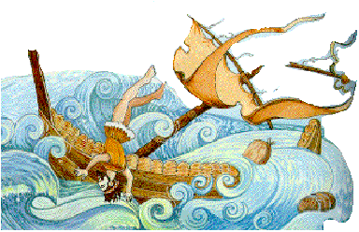
What the characters learn
Odysseus learns that his fate is not in his hands
Odysseus learns of the wrongdoing he has done to Elpenor

Slide 21
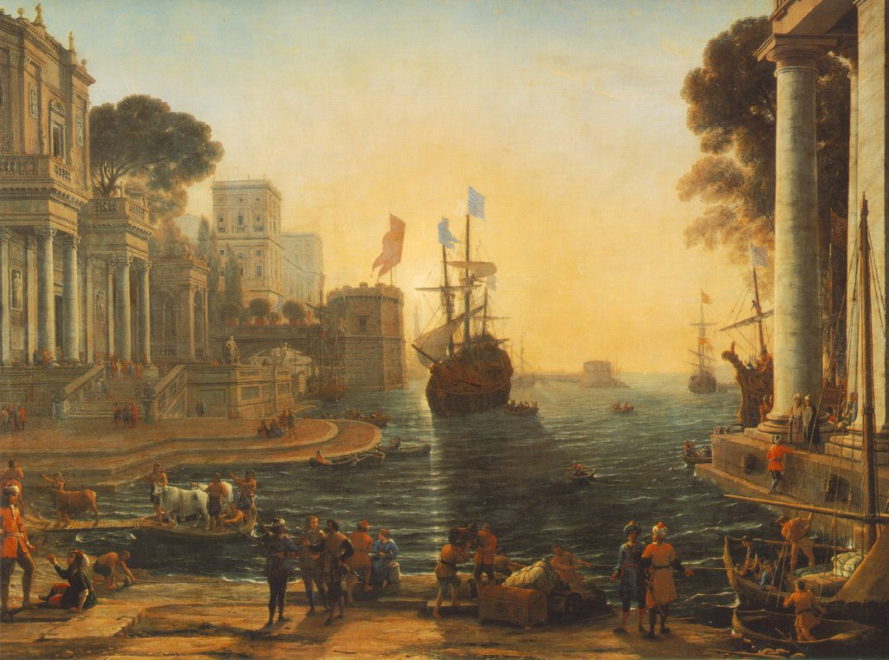
Significant Passages

Slide 22
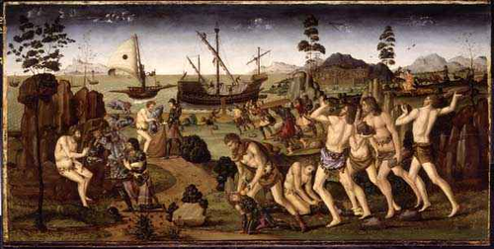
“Anguish lies ahead; the god who thunders on the land [Zeus] prepares it…one narrow strait may take you through his blows: denial of yourself and your shipmates…and don’t raid the beeves”
Troubles that lie ahead can be avoided with restraint. We know this is unlikely because of how the crew members have behaved in the past episodes.

Slide 23
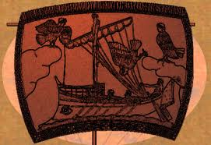
“Under a strange sail shall you come home”
We know this will happen because we meet Odysseus when he is accepting a new and strange ship from Phaecians.

Slide 24
Discussion Questions

Slide 25
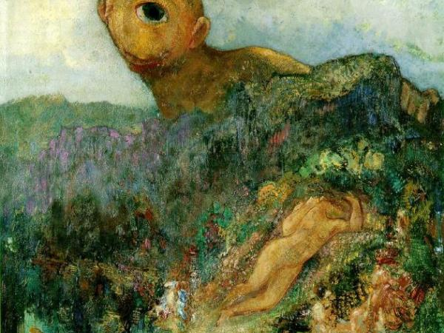
What does the ghost of Elpenor request?

Slide 26
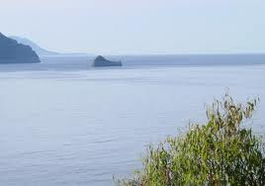
What does Tiresias foretell?

Slide 27
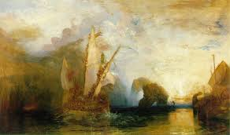
What directions and warnings does Tiresias give?

Slide 28
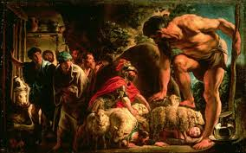
What character traits does Odyseus display in this episode that he did not reeveal in his adventure with the cyclops?

Slide 29
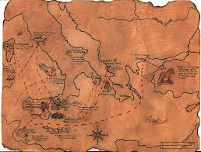
What is Odysseus’ reaction to his mother’s ghost?

Slide 30
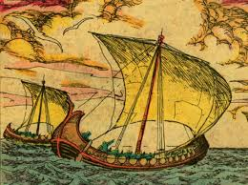
Do Tiresias’ predictions and advoce seem reasonable to you, why or why not?

