Slide 1
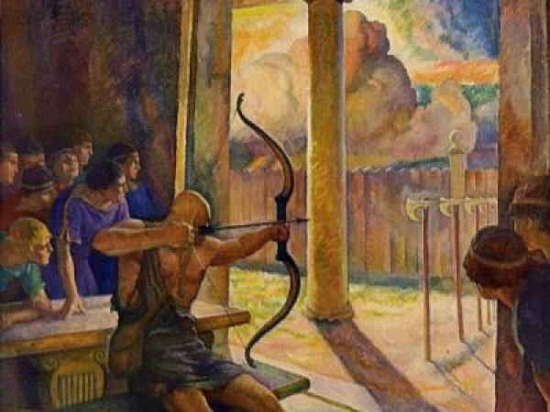
The Challenge
By Rebecca Lauler, Samantha Glazer and Clare Scott

Slide 2
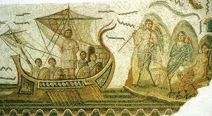
Necessary Background
Penelope, Odysseus’ wife, has been waiting for her husband to return from war for about 20 years.
Her parents want her to remarry since they are unaware whether or not Odysseus is coming home.
The suitors want to be Penelope’s husband and to take Odysseus’ spot on the throne.
For the past 20 years she has been outwitting the suitors so she does not have to marry them.

Slide 3
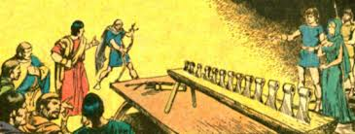
Necessary Background
Penelope meets Odysseus while he is disguised as an old man; he tells her he knows her husband and he will return in a full moon (in a month).
Penelope creates the arrow and axe hole challenge in order to buy herself time for Odysseus to return so she does not have to marry a suitor since she knows only Odysseus can achieve the challenge.

Slide 4
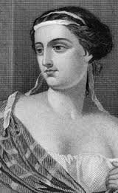
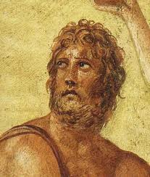
Characters
- Penelope: wife of Odysseus, over the time that he
has been at war (about 20 years) she has stayed true
to him and never second guessed loving him, very intelligent and beautiful
-Odysseus: determined to get his wife and throne back after war

Slide 5
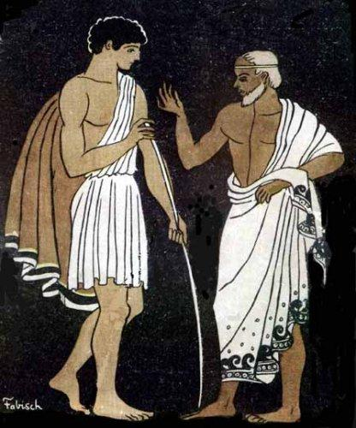
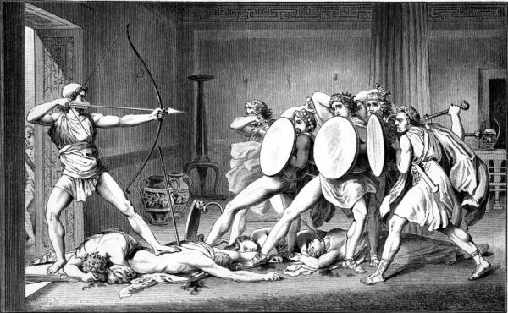
Characters
-Telemachus: son Of Odysseus, knows who his father is even with his disguise as an old man
-The suitors: men who want to take Odysseus’ throne and to be Penelope’s husband, fail to pass the arrow and axe hole challenge

Slide 6
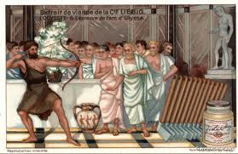
Main Conflicts
- Man vs. Man: Odysseus has to go against all of the suitors to get Penelope and his position as a king back, in order to get his spot back he has to shoot an arrow through 12 axe holes
-Man vs. Self: Penelope has to decide who to marry since she does not know that Odysseus has returned because of his disguise
- Man vs. Self:While Odysseus was at war, Penelope had to believe that he was eventually going to return home, she wouldn’t know whether or not he died, or married someone else

Slide 7

Brief Summary
After Odysseus returns home, he decides that he is going to stay in disguise so that he can kill the suitors and claim his spot on the throne again. Many suitors want to take his throne so Penelope creates an impossible challenge that only Odysseus can complete. In order to win the challenge, you have to be able to string Odysseus’ bow and shoot the arrow through 12 axe handle holes, something only Odysseus can accomplish.

Slide 8
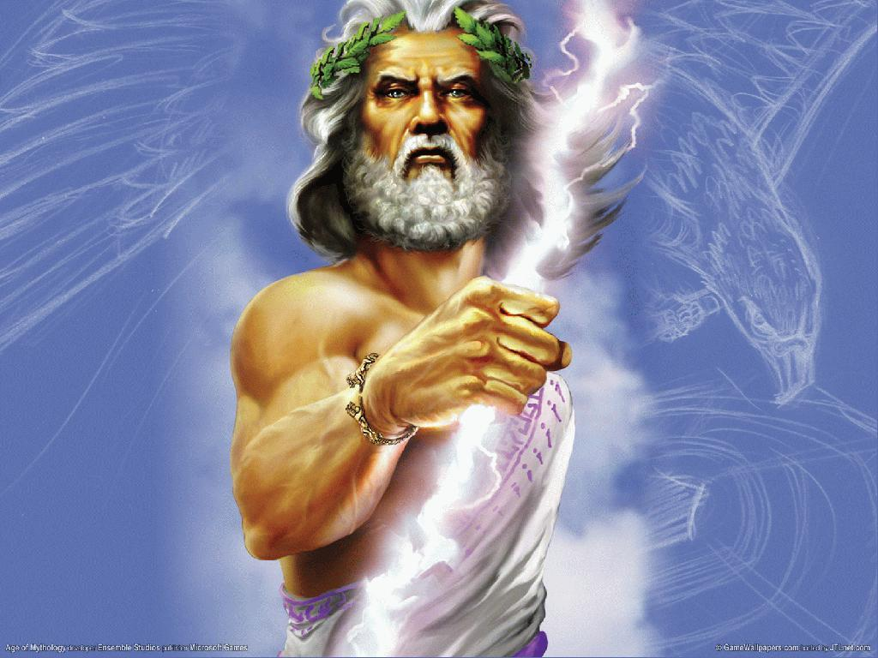
Brief Summary
The suitors attempt shooting the arrow and fail. Odysseus, in disguise, asks for a try at shooting the arrow and strings the bow. He successfully shoots the arrow making it through all 12 axe handle holes. All the men are shocked by his achievement and Zeus’ thunderbolt.

Slide 9
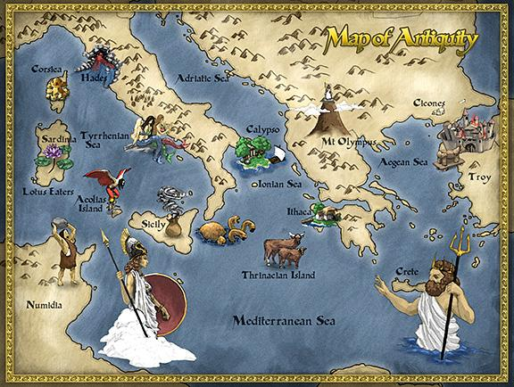
Odysseus’ Motivation
Since Odysseus wants to return home to his wife and his home, his is motivated to continue his journey. He has been gone for 20 years and wants to live the same way as he did before he left for war. He does not want one of the suitors to marry his wife and he wants to win the challenge so that he can call Penelope his own wife once again.

Slide 10
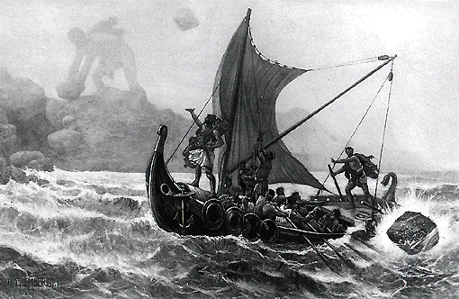
Theme
In the episode “The Challenge”, Homer proves that loyalty, wittiness and self discipline in times of struggle can get you ahead in life.

Slide 11
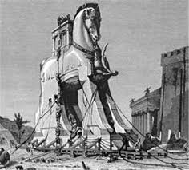
what the characters learn
Telemachus learns that his father has returned from war and is actually in disguise as an old man.
Penelope learns loyalty. She stayed true to Odysseus while he was at war and during his journey home.
Odysseus learns self discipline.

Slide 12
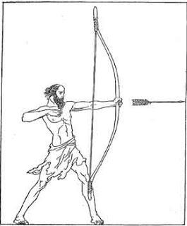
significant Passage
“Telemachus, the stranger you welcomed in your hall has not disgraced you. I did not miss, neither did I take all day stringing the bow.”
After Odysseus had completed stringing the bow, he successfully shot the arrow through all 12 axe handle holes. Odysseus knew exactly how to sting his own bow quickly and how to aim correctly in order to win the challenge.

Slide 13
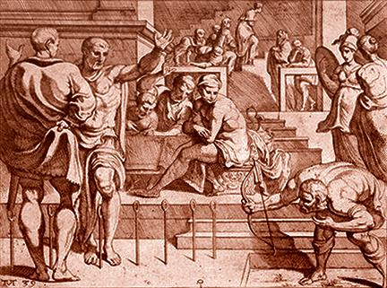
Significant passage
“He dropped his eyes and nodded, Prince Telemachus, true son of King Odysseus, belted his sword on, clapped hand to his spear, and with a clink and glitter of keen bronze stood by his chair, in the forefront near his father.”
This shows that Telemachus knew the old man was his father after he had shot the arrow through all holes.

Slide 14

Discussion Questions
Why did Penelope set up an impossible challenge that only Odysseus could complete?
Why did Odysseus disguise himself as an old man upon returning to Ithaca?
Do you think the challenge blew Odysseus’ disguise to Penelope?

Slide 15

Videos
Clip made by a student to represent the impossible challenge of stringing Odysseus’ bow, and shooting an arrow through 12 axe holes:
http://www.youtube.com/watch?v=7GHFxn-_4Ks
Scene from The Odyssey of challenge: (stop at 4:01)
http://www.youtube.com/watch?v=w4WIpO2xrHs

