Slide 1
Penelope’s Tests
By: Ean Waetjen

Slide 2
Background
- Odysseus killed Antinous, Eurymachus and the rest of the suitors
- Telemachus tells his father to spare the bard Phemius and the herald Medon

Slide 3
Summary
- Odysseus reveals himself to Penelope, but she suspects him of being someone else in disguise
- She tests him by telling Eurycleia “Place it [his bed] outside the bedchamber my lord built with his own hands.”
- Odysseus then gets angry as he knows that Penelope knows that no one can move the bed as it is carved from an olive tree

Slide 4
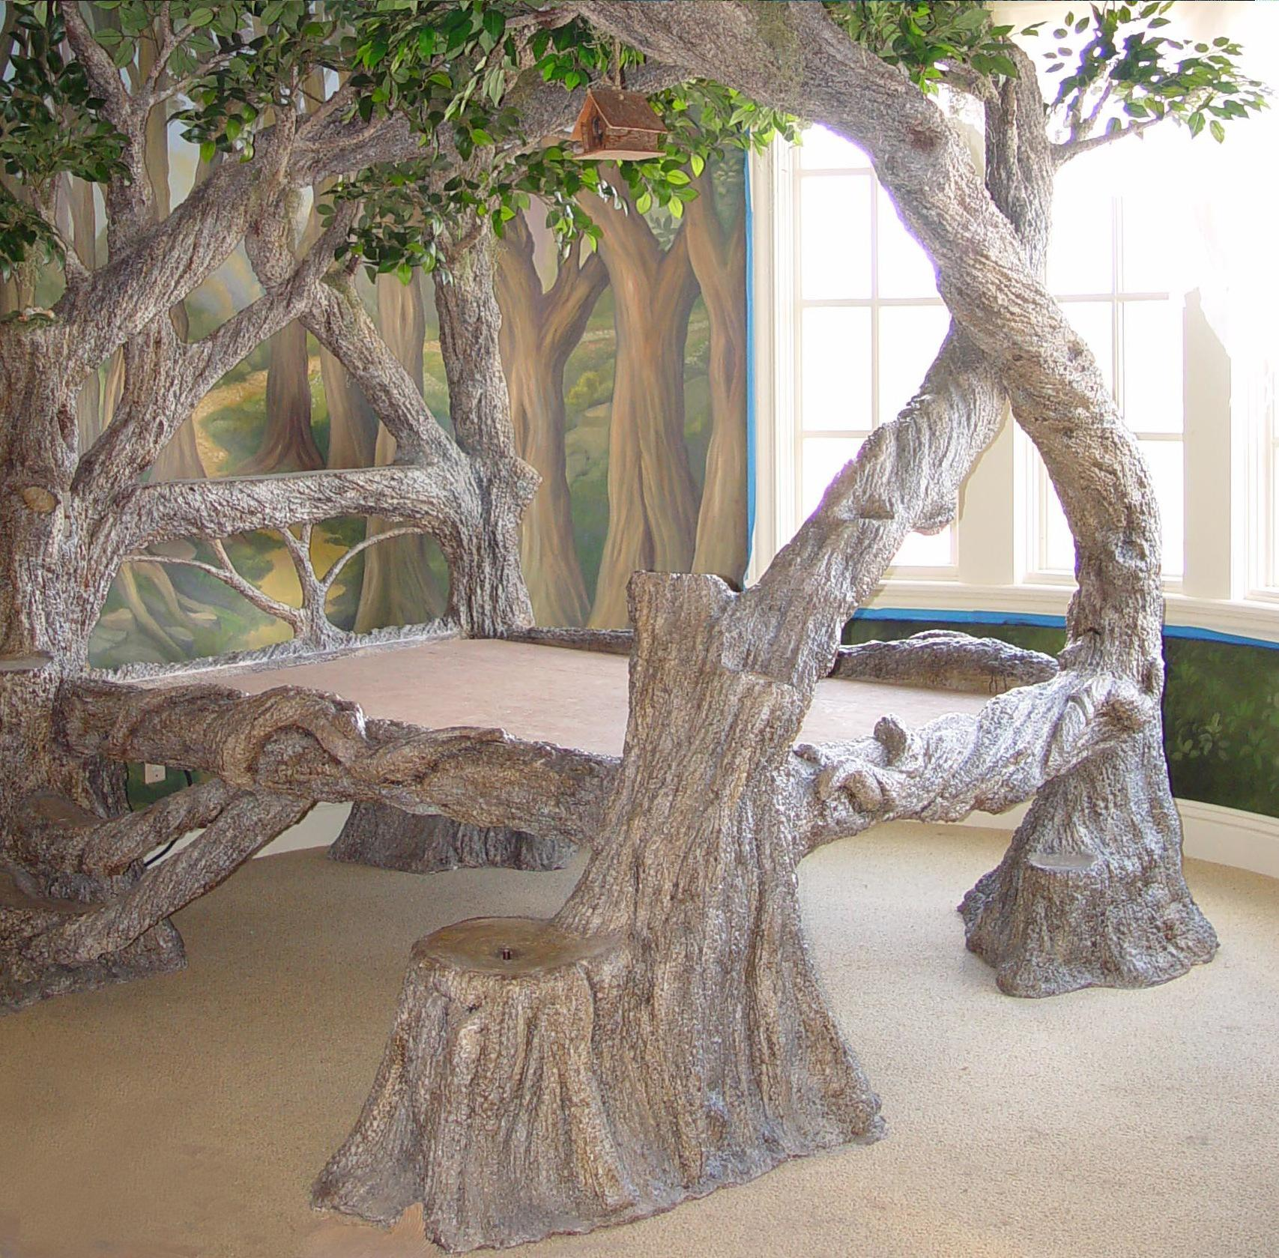
Odysseus’ Bed

Slide 5
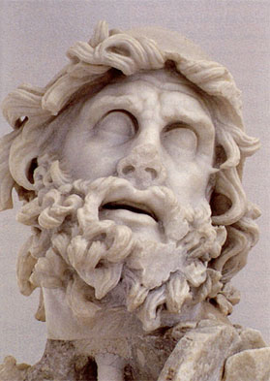
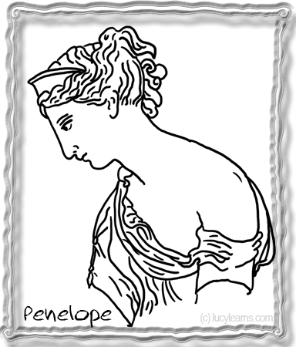
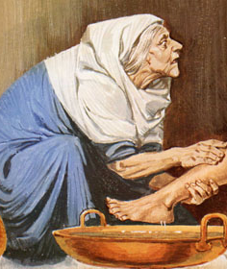
Characters
- Odysseus - The hero of the story; king of Ithaca
- Penelope - Odysseus’ wife; queen of Ithaca
- Eurycleia - Penelope’s servant
- Telemachus - Son of Odysseus and Penelope

Slide 6
Conflict
- Penelope vs. Society: She has to relearn how to trust people, as she had to harden against the world so she wouldn't be tricked by the suitors

Slide 7
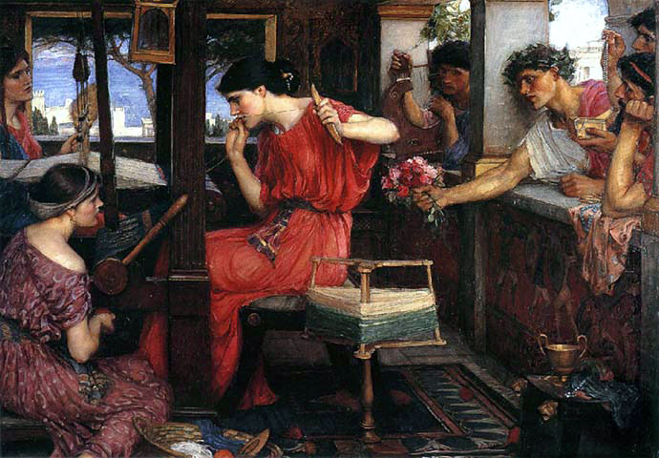
Penelope and her suitors

Slide 8
Odysseus’ Motivation
- Odysseus is finally home but he must regain Penelope’s trust so they can become a family again

Slide 9
Theme/Lesson
- Never give up hope
- Hope and loyalty are rewarded in the end
- The characters learn these lessons in the end

Slide 10
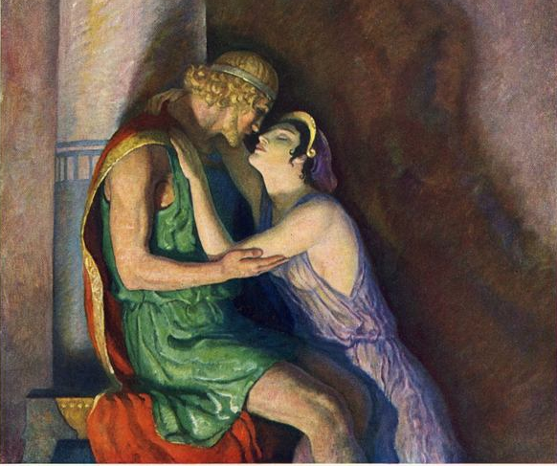
Penelope and Odysseus Reunited

Slide 11
Significant Passages
- “Woman, by heaven you’ve stung me now! Who dared to move my bed? No builder had the skill for that - unless a god came down to turn the trick. No mortal in his best days could budge it with a crowbar. There is our pact and pledge, our secret sign, built into that bed - my handiwork and no one else’s!”

Slide 12
Significant Passages (Cont.)
- “Their secret! as she heard it told, her knees grew tremulous and weak, her heart failed her. With eyes brimming tears she ran to him, throwing her arms around his neck, and kissed him...”

Slide 13
Discussion Questions
- Why is Odysseus angry when Penelope says to move the bed?
- Why didn’t Odysseus and Penelope tell anyone about their bed being made of the olive tree?
- Do you think the ending was created by someone other than Homer?

