Slide 1
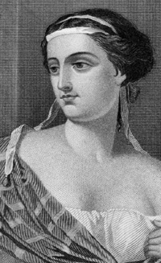
Penelope
By: Diana Cha & Ally Jewell

Slide 2
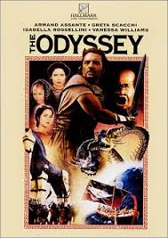
Background on Odyssey
Odyssey is queen Penelope's husband
Odyssey left for troy 20 years ago
He's doing all he can to get home
He’s arrogant
Faces many challenges

Slide 3
Characterization on Penelope
Penelope is often left in the dark ( not told things )
Sad most of the time
Doesn't lose hope on Odysseus coming back
Athena come to Penelope in her dreams and comforts her
Heartbroken
She's loyal
She's also clever

Slide 4
Suitors
Though her love for odyssey is undying she still responds to the suitors
She puts off the decision to chose a suitor
Feels pressured by the suitors to remarry
Has to eventually tell them what is going on
Tells them she doesn't have time for them

Slide 5
Important quotes
“I have no strength left to invade marriage and cannot find any further way”
She doesn't want to marry but realizes she cant hold it off any longer, she kept telling them that when she finishes the weaving the tapestry she will marry. However every night she un weaves it.

Slide 6
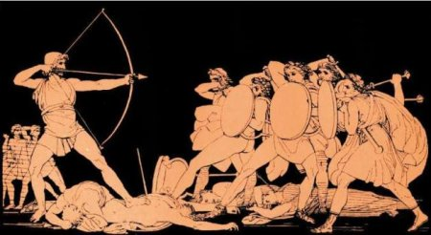
Symbolism
Foreshadowing: when Penelope always talks about him coming back
Dramatic Irony: We know that the beggar is Odysseus but she doesn't and she tells him everything

Slide 7
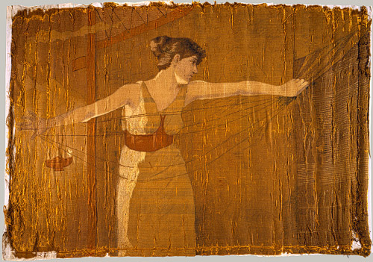
Internal Conflict
Penelope has an internal conflict with her self. She doesn't want to believe that odyssey might not come back, she keeps hoping that he will return. Many people tell her but she doesn't want to believe it

Slide 8
Discussion Questions
What is the relationship between Penelope and Odysseus? Does he reveal himself to her? Why or why not?
How has Penelope been able to avoid marriage for many years?
What challenge does Penelope create for the suitors?

Slide 9
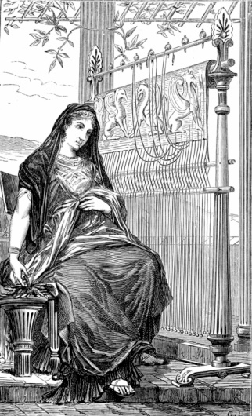
Summary
Penelope is worried about her husband and is waiting for his return, also is trying to keep the suitors off her until his arrival. Athena helps Penelope through all of her troubles. She has to also take care of the son telemachus by herself. Heartbroken without her husband Odysseus.

