Slide 1
Odysseus’ Revenge
Martin Bustamante, Jack Samett, Rafael Madera

Slide 2
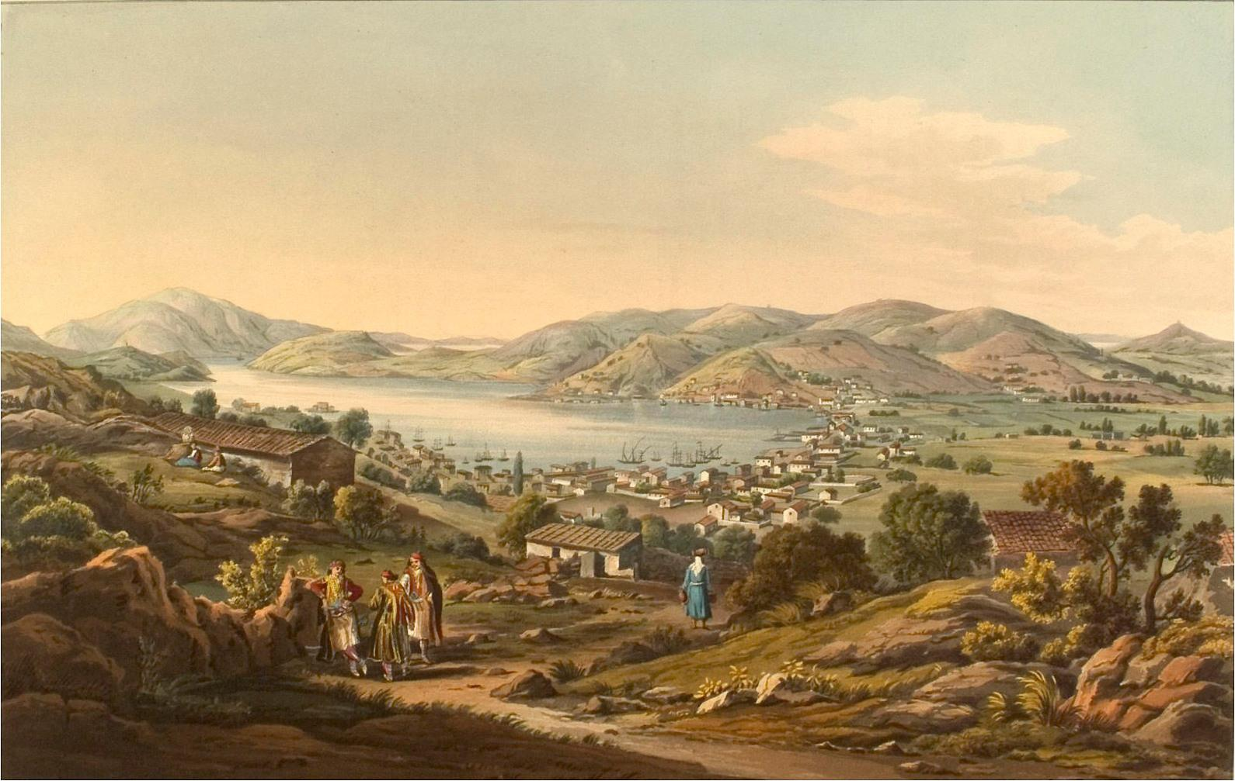
Background
-Odysseus returns to Ithica
-He discovers the men that tried to have relations with his wife, Penelope, while he was gone

Slide 3
Summary
-Odysseus goes to battle with his own people because the suitors attempted to replace him as Penelope’s husband
-Odysseus, his son, and a few loyal mates fight the other men
-All of the opposing men are killed

Slide 4
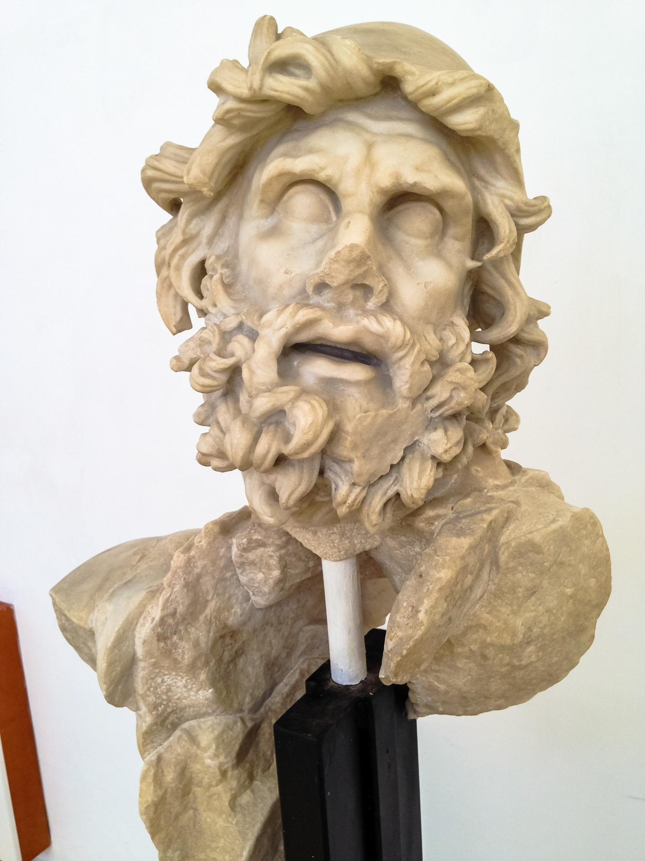
Main Conflicts
-Odysseus feels betrayed by his people
-Battle occurs between Odysseus’ loyal men and the suitors of Penelope
-Odysseus comes out as victor

Slide 5
Characters
-Odysseus; old king and husband of Penelope that return from a 20 year voyage
-Telemachus; Odysseus’ son
-Antinous; ringleader of the suitors
-Eurymachus; leads the opposing force into battle

Slide 6
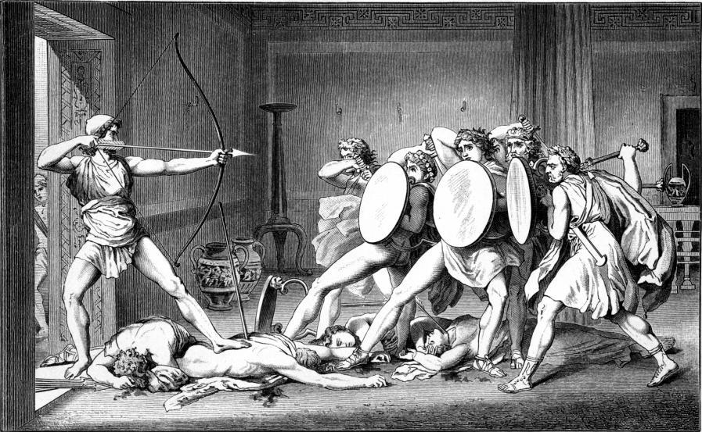
Odysseus’ Motivation
-Odysseus is angered by the fact that the people of his land would betray him and go after Penelope
-Odysseus wants to seek revenge on those who attempted to marry Penelope

Slide 7
Questions
- Should Odysseus have killed all of the men?
- Did the suitors have a right to try to replace Odysseus?
- What do you think would have happened if Odysseus died?

Slide 8
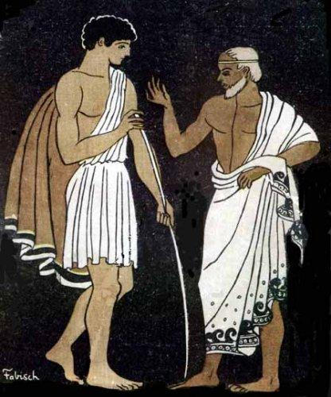
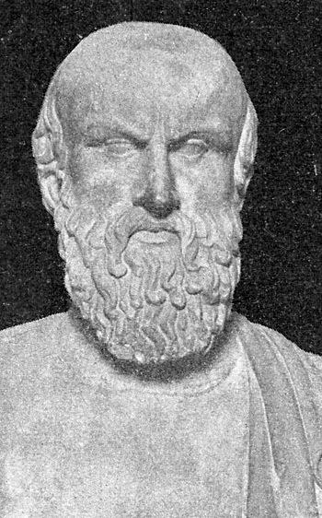
Theme/Lesson
-The main theme of this passage is to be loyal to those you know and to not betray them

Slide 9
What the Characters Learn
-The suitors learn that to betray Odysseus is a terrible idea and to be loyal
- Telemachus learns to be a man and to stick with his father, when he fights with Odysseus and does a good job
http://www.youtube.com/watch?v=-nvjiHXn_2w

Slide 10
Important Quotes and Passages
- “After me, everyone rush him where we stands” P.699 ; Eurymachus
- “You forced yourselves upon this house. Fight your way out, or run for it, if you think you‘ll escape death. I doubt one man of skins by” p.698; Odysseus

