Slide 1
The Lotus-Eaters and The Cyclops
Rivu Ghosh, Nina Carbone, Emily Berberich and
Rebecca Schmidt

Slide 2
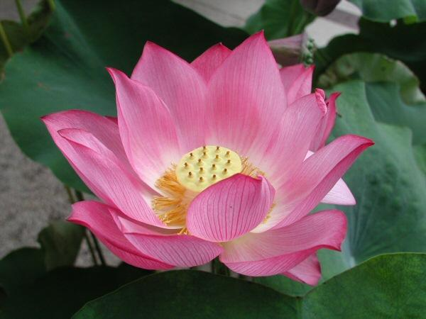
The Lotus-Eaters: Summary
Zeus conjures up a 3 day storm for Odysseus and his men, so they cannot sail.
Odysseus is sailing home, the current takes him out to sea.
For 10 days they drift until they reach the island of the Lotus Eaters.
The Lotus Eaters show no harm but offer them fruit of the Lotus.
The men who eat the fruit of the Lotus never want to return home because the Lotus has a drug-like effect.
Odysseus ties up the men and tells them not to eat the Lotus. Then they leave the island.

Slide 3
The Lotus-Eaters: Characters
Lotus Eaters: creatures that appear innocent, offer Odysseus and his men the fruit of the Lotus
Odysseus’ Men: Unintelligent, foolish people who fall under the influence of the Lotus fruit
Odysseus: has good judgement, protective of his men, determined

Slide 4
The Lotus-Eaters: Conflict
Zeus’ storm vs. Odysseus and his men
The Lotus Eaters vs. Odysseus and his men
The Lotus fruit vs. Odysseus
Odysseus vs. Odysseus’ men
Odysseus vs. Odysseus

Slide 5
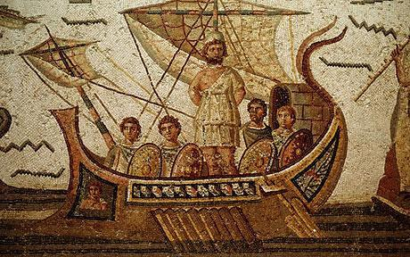
The Lotus-Eaters: Odysseus’ Motivation
Protect his men from the Lotus Fruit, so that he is able to get home to his family.

Slide 6
The Lotus-Eaters: Theme/Lesson
Things are not always as they seem:
-The Lotus Eaters seem very innocent and friendly at first, but they reveal themselves when they offer Odysseus and his men the drug-like fruit of the Lotus.
Odysseus’ men learn that they should not go on their first instinct.
-Odysseus learns that he is incharge and needs to control his foolish crew.

Slide 7
The Lotus-Eaters: Significant Passages
“ ...those who ate this honeyed plant, the Lotus, never cared to report, nor return: they longed to stay forever, browsing on that native bloom, forgetful of their homeland…” (649)
This passage shows the effect the flower has on Odysseus' men. If Odysseus had this flower he would never want to go home to his family.

Slide 8
The Lotus-Eaters: Discussion Questions
What are some modern day equivalents to the Lotus Fruit?
Why do you think the Lotus is chosen to represent a drug-like plant?
Why do you think the author included this as one of the key stories of in the Odyssey?

Slide 9
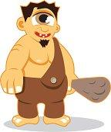
The Cyclops:Background Information
The Cyclops- one eyed giants that have relations with the gods. ex: Polyphemus is Poseidon’s son.

Slide 10
The Cyclops: Summary
Odysseus and his men arrive at the land of the Cyclops,
Odysseus’ men want to raid the cave they come across.
The cave’s owner returns and it is the Cyclops, Polyphemus, son of Poseidon.
Polyphemus shows hospitality at first, but soon he becomes violent and eats 2 of Odysseus’ men and traps the rest of them in his cave.
Odysseus gives Polyphemus wine as a friendship token. As Polyphemus falls asleep Odysseus pokes his eye so that he is unable to catch them.
Polyphemus tries to catch them in the end, but he fails.

Slide 11
The Cyclops:Characters
Odysseus-becomes arrogant, but tries to protect his men from the cyclops.
Polyphemus- one-eyed giant, son of Poseidon, nice at first then turns violent towards Odysseus and his men.

Slide 12
The Cyclops: Main Conflicts
Odysseus v.s. Polyphemus
Polyphemus v.s. Odysseus’ men
Odysseus v.s. Odysseus’ men

Slide 13
The Cyclops: Odysseus’ Main Motivation
Odysseus’ motivation was to get out of the cave, keep himself safe and get his men off the island alive.

Slide 14
The Cyclops:Theme/Lesson and what the characters learned
Do not take what does not belong to you.
DO NOT ANGER THE CHILDREN OF THE GODS!
Do not be arrogant.

Slide 15
The Cyclops: Significant Passages
".. how you were put to shame and blinded, tell them Odysseus, raider of cities, took your eye: Laertes' son, whose home's on Ithaca! "
This passage shows the mistake Odysseus made while leaving the island because he was being arrogant, he did not realize he gave his name and homeland to a child of a God.

Slide 16
The Cyclops: Discussion Questions
How can Odysseus’ arrogance hurt him later on?
Do you think Polyphemus will show up again during Odysseus' journey back home?

Slide 17
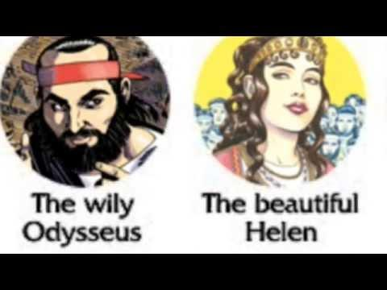
2:35-5:15
Notes:
2:35- 5:15

