Slide 1
Argus and the Suitors
By MinJi Kang, Jenny Choi, and Brianna Cunney

Slide 2
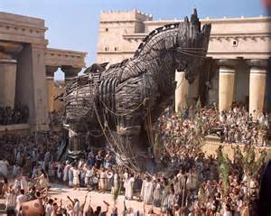
Background
Odysseus comes back home.
Suitors try to seduce Penelope to marry them.
Odysseus plans to attack his suitors.
Disguises as a beggar and only Telemachus knows.

Slide 3
Odysseus
King of Ithaca and disguises as a beggar to see his kingdom’s loyalty and to attack the suitors.
Penelope
Odysseus’ wife. Ignores marriage proposals from the suitors. Shows faith towards Odysseus.
Telemachus
Odysseus’ son. Only one who knows about Odysseus disguising as a beggar, but has to act like he doesn’t.

Slide 4
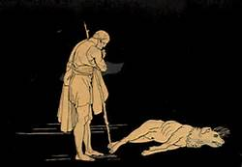
Argus
Odysseus’ old hunter dog. Only one who recognizes Odysseus after the disguise. Dies because of an infection and old age. Shows faith and loyalty.

Slide 5
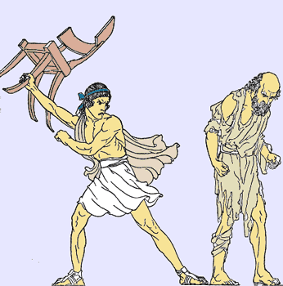
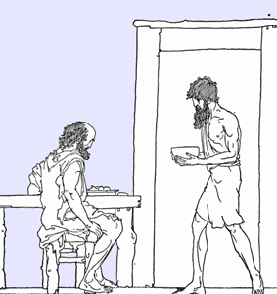
Antinous
The most arrogant and obnoxious suitor. Main antagonist. Gets into an argument when Odysseus returns as a beggar.
Eumaeus
Odysseus’ faithful servant. Helps Odysseus to get back to Ithaca and when Odysseus is disguised as beggar.
Eurynome
Penelope’s housekeeper.

Slide 6
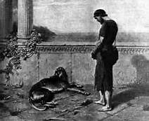
Argus: Summary
-Argus: Odysseus’ hunter dog, but never went hunting with Odysseus.
-Argus waits faithfully for Odysseus
-Argus notices Odysseus disguised as a beggar, but Odysseus pretends like he didn’t see Argus
-Argus dies because of his age and infections.

Slide 7
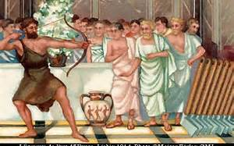
The Suitors: Summary
-Antinous yells at Odysseus disguised as a beggar when he enters his home.
-Odysseus gets angry and argues with antinous.
-Other suitors stop Antinous from arguing.
-Penelope calls the beggar over to talk with him if he heard about Odysseus.

Slide 8
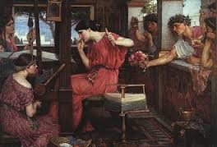
Conflict
-Odysseus is angry at the suitors trying to marry Penelope.

Slide 9
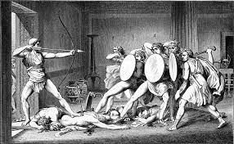
Odysseus’ Motivation
-Attack the suitors who tried to marry Penelope. -Test the loyalty of his kingdom when he is not there.

Slide 10
Symbolism
Loyalty/Faith:
-Argus was loyal to Odysseus by waiting for him after he left for the war. Despite the fact that he is dying because of infections, he waits and dies after he sees Odysseus.
-Penelope was faithful and loyal to Odysseus by rejecting all the proposals from the suitors. She was kind to the beggar and questioned him if he heard about Odysseus.

Slide 11
What the Characters Learn
Argus: If you have faith in something, what you will for will happen
Telemachus: You need to be confident and calm in order to succeed.

Slide 12
Significant Passages
-“You know how servants are: without a master they have no will to labor, or excel.” - Eumaeus
-“Antinous hit me for being driven on by hunger… If beggars interest the gods, if there are Furies pent in the dark to avenge a poor man’s wrong, then may Antinous meet his death before his wedding day!” – Odysseus
“If all we pray for came to pass, not one would live till dawn!” - Eurynome

Slide 13
Discussion Questions
Argus
What was Argus like in his youth?
Why doesn’t Odysseus greet Argus?
Is Argus’ death just when Odysseus returns a coincidence?

Slide 14
Discussion Questions
The Suitors
Was Odysseus right in not striking back at Antinous?
Why do the other suitors speak against Antinous?
Compare and contrast Telemachus’ behavior and Odysseus’.

